Slide 1
The Right Write Writes Right, Right?
Correct!
Notes:
Setup: size Terminal and VSCode to a large font, turn off VSCode mini map, toggle Screencast Mode, go to light mode
Switch to the code repo and open the initial branch
Close everything, especially email
Remember to allow sound passthrough in Teams/Zoom
Put Discord on DND

Slide 2

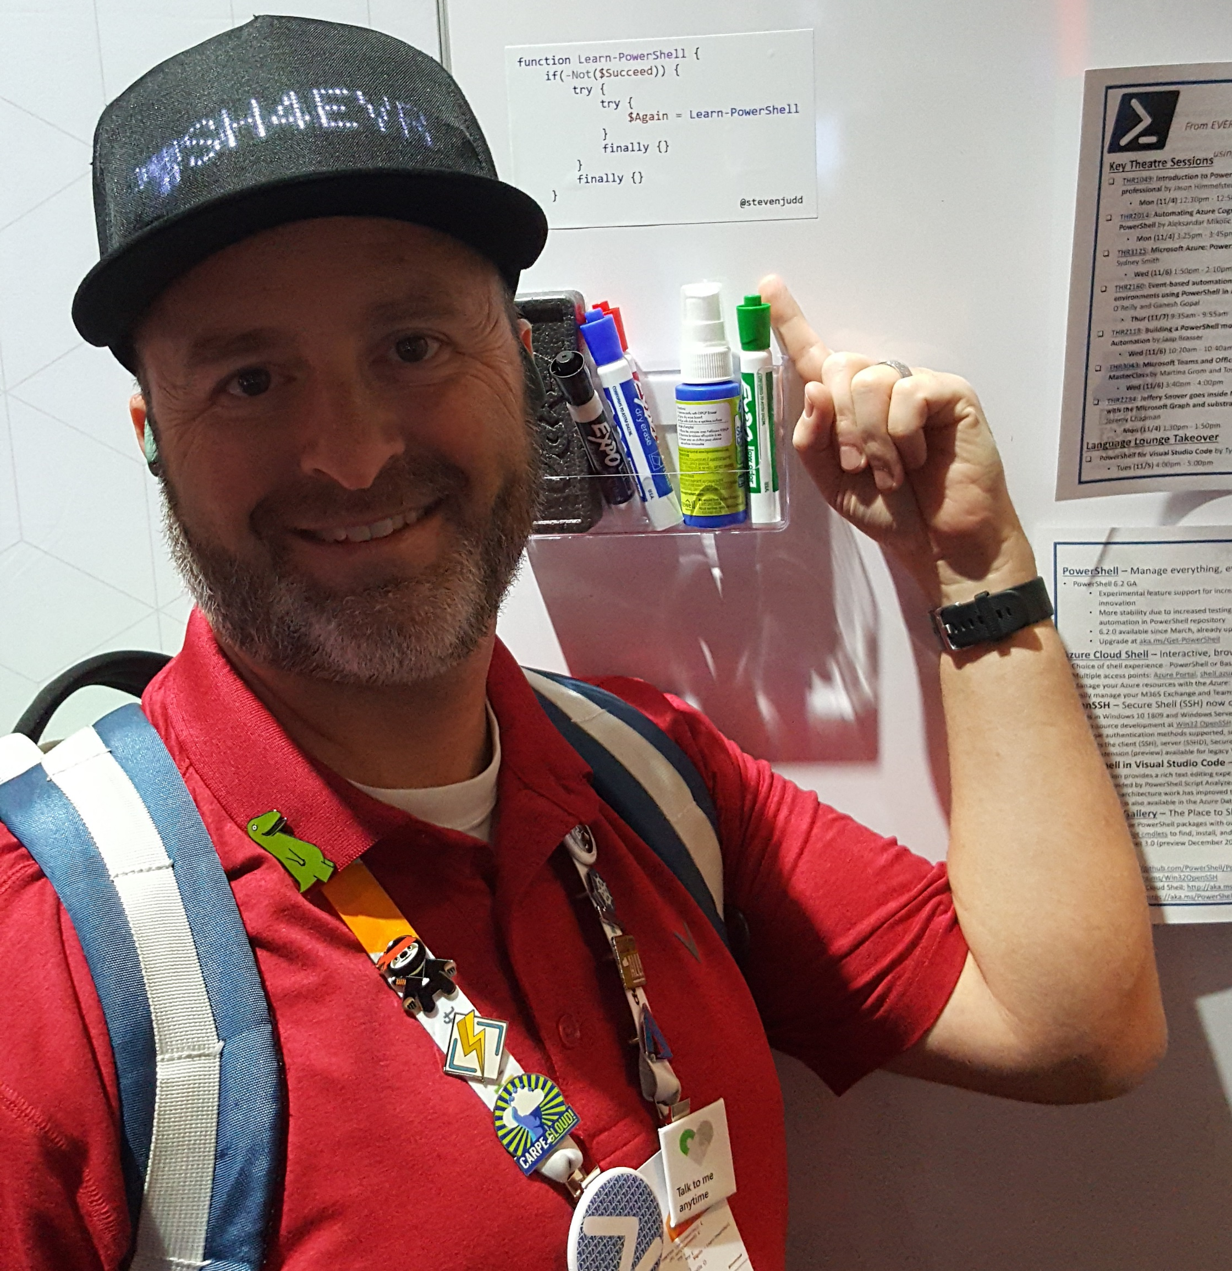
Who Am I?
Steven Judd
Multi-year, multi-discipline IT Pro
PowerShell enthusiast
Dad joke enthusiast
Fashion icon
Maybe not…
Wut?

Slide 3
The Outline
What are streams?
Console-based streams
Redirection
PowerShell-based streams
A call to Action
Preferences
Points to ponder

Slide 4
Streams Definition
Interconnected input and output communication channels between a program and its environment
From Standard streams - Wikipedia)

Slide 5
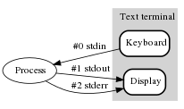
Console Streams
Standard input (stdin)
Standard output (stdout)
Standard error (stderr)

Slide 6
Redirection
What you call it when you tell a stream where to go twice, right?
It’s a joke. You only have to tell a stream where to go one time
2>&1 will redirect the Error stream into the Success stream
Typically, you see this when you want to capture the output to a log and you wish to send the success and failure messages into one file
I have never used redirection
Well…maybe rarely, but only on other people's code
I follow the proper use of the streams in my code rendering redirection unnecessary
Exceptions exist
More details: about_Redirection - PowerShell | Microsoft Docs

Slide 7
PowerShell -gt cmd.exe
PowerShell has more streams than the standard console
Six streams to be exact
Write cmdlets from Microsoft.PowerShell.Utility send data to these streams
This is how to control output into the streams
Time to jump into the streams with both feet
I like jokes that really make a splash

Slide 8
Success Stream
Also known as Output Stream or Success Pipeline
What is displayed in the console by default
Comes from Out-Host
Hold up now, Out-Host is not a Write command
Out-Host is automatically appended to every PowerShell command
Out-Host has one parameter: Paging
Thus, you can use “| Out-Host –Paging” to get more
I find it faster to type “| more” plus I am more familiar with more

Slide 9
Success Stream cont. (More)
Did you say you want more “more”?
“More” in WindowsPowerShell is a Function with a single Parameter
gcm more | select -exp scriptblock
“more” calls more.com to return more, unless you pass paths, then more will get the content of the paths to pass to more.com, resulting in more content for more.com to more against
Or some might say, to “more on”
“More” in PowerShell 7 is the more.com application
gcm more
Notes:
Show this by using Windows Terminal to open PowerShell and Windows PowerShell and entering the commands

Slide 10
Success Stream via Write-Output
Write-Output sends the specified objects to the next command in the pipeline
If there isn't a pipeline, it sends to Out-Default, which is added to the end of every pipeline.
Didn't you say that Out-Host is automatically added?
Yes, but Out-Default comes before Out-Host to evaluate whether there is a registered view for the object type being passed. According to the help, the view specifies which properties to display and how they should be displayed.
Since Out-Host is added by Out-Default automatically, Write-Output will pass the objects across the non-specified pipeline to Out-Default, which will check for formatters and add the relevant types and pass to Out-Host, which will write those objects to the console.
How PowerShell Formatting and Outputting REALLY works | PowerShell Team (microsoft.com)

Slide 11
Don’t use Write-Output
Seriously, don’t
Wut? Why?
It is slow
All it does is wrap Cmdlet.WriteObject() which is already called by default when outputting to the Success Stream
Mark Kraus knows better than we do
Get-PowerShellBlog: Let’s Kill Write-Output

Slide 12
Error Stream
Thank goodness this one is easy (riiiight?)
Errors that occur in the console will go to the error stream and be stored in the $Error variable in reverse order
But how do these errors get in there?
Notes:
Side note: When there are many errors, some people describe this as “console bleeding” because of all the red

Slide 13

Error Stream via Write-Error
Write-Error will send a non-terminating error to the error stream and will also store the error in the $Error variable
If you want to end after Write-Error you will need to code this action
I like to catch any errors in a Try/Catch block and then either use Write-Error followed by Return or use Throw to write the error and then end processing
What is the difference between Write-Error and Throw?
Write-Error is non-terminating
Throw is terminating
Both send their output to the Error Stream and $Error
Demo

Slide 14
Terminating vs Non-Terminating
Terminating errors do not continue running the code when they occur
Non-Terminating errors return the error but continue running the code
ErrorActionPreference and the ErrorAction parameter only work on non-terminating errors
Thus, if you use a cmdlet that has a terminating error, you must use a try/catch block to keep from returning this error because it will not honor the ErrorAction parameter value or ErrorActionPreference

Slide 15
Error Stream Best Practices
Errors are for displaying something that has failed
Do not set $Error = $null and clear out all the errors. It is abusive to your users to remove errors that they may have needed without their consent.
Do not change the $ErrorActionPreference
Come at me, bro!
Use -ErrorAction Stop to generate terminating errors instead
I will grant that if you are writing a Function, setting $ErrorActionPreference = Stop will only change the Function scope and not the Script or Console scope, so it is somewhat safe.
Do not change the color of Write-Error text
Come at me, bro!
Errors are red
This is a standard
Please don’t modify standards
Think of the children

Slide 16
Warning Stream
Warning messages aren’t failures
However, it is important enough to show an interactive user information they need to know that may cause a problem
Can be used to prompt the user to see if they want to continue processing
Will cover later
Where you might see a warning message:
Az Module cmdlets give warning information on upcoming breaking changes to the cmdlets.
Example:
New-AzPublicIpAddress

Slide 17
Warning Stream via Write-Warning
Prepends the message with the stream name
Doesn’t require a setting change or a parameter to display
Change the InformationAction to Continue
Demo
Best Practice:
Use Warnings like other cmdlets do
Give important information that is not worthy of stopping the execution or storing the output in the $Error variable and increasing the error count

Slide 18
Verbose Stream
Give additional information, but only when requested
Use of Write-Verbose requires your code to be an advanced function
Two ways to make your code an advanced function
Adding [CmdletBinding()]
Adding [Parameter()] to any defined parameters

Slide 19
Tangent on Advanced Function Common Parameters
What parameters are added to a function when it becomes advanced?
Verbose (vb)
Debug (db)
ErrorAction (ea)
WarningAction (wa)
InformationAction (infa)
ErrorVariable (ev)
WarningVariable (wv)
InformationVariable (iv)
OutVariable (ov)
OutBuffer (ob)
PipelineVariable (pv)
Take note that only Verbose and Debug switches match the Write cmdlets

Slide 20
Verbose Stream Caveats
You can change the $VerbosePreference to output Verbose stream content without the Verbose switch or the code being an advanced function
Please don’t
You can add the -Verbose switch to the Write-Verbose command to return the output
Why?
Please don’t

Slide 21
Verbose Stream via Write-Verbose
Use when you want to give status of script updates
For example, when looping through items, show what item you are on
Use instead of Write-Host for information only updates
Opinion: When to use Write-Verbose vs Write-Host
Consider your users’ experience
Don't let them think your code is not working
Based on how long a particular step of code takes, it may be more helpful to use Write-Host
Demo

Slide 22
Verbose Stream Best Practices
Use Write-Verbose where you typically use inline comments
This is more art than science
Don't annoy your users
Don't flood them with useless info
Do give relevant feedback

Slide 23
Debug Stream
Give debug information, but only when requested
I’ve rarely used this stream
The debug stream goes back to PowerShell 2.0 (I couldn't find if it was in 1.0)
Once Integrated Scripting Environments became available, they replaced the need for the debug stream for interactive evaluation
However, if you are running code non-interactively then you may need full information on an object and would want to use the debug stream to return this data

Slide 24
Debug Stream via Write-Debug
Used when you want to send debug information
Similar to Write-Verbose in functionality
Demo
Best Practice
Use VSCode or ISE to debug your code
Seriously. Not a joke.
Unless you need to get non-interactive data and you need the full object data output for review

Slide 25
Information Stream
Added in PowerShell 5.0 to stop killing puppies
See Don Jones and Write-Host
Allows the capturing of informational messages
Since Write-Host output cannot be captured
Yes, I know about Start-Transcript
Yes, Start-Transcript is a hack and I avoid it
Come at me, bro!

Slide 26
Information Stream via Write-Information
By default, Write-Information doesn’t write anything
Wut?
$InformationPreference is set to SilentlyContinue by default
Capture the output using the InformationVariable
Change the InformationAction to Continue
Demo

Slide 27
Information Stream Best Practices
Use Write-Host for colors
Use Write-Information to capture the data

Slide 28
Progress Stream
The what now?
Did you know there was a Progress stream?
Used to communicate progress via a custom defined progress bar
Un-numbered stream
Output can't be redirected

Slide 29
Progress Stream via Write-Progress
Use when the building of data may take a while
Consider the user experience
Demo

Slide 30
Call to Action
Use the Action parameters to change how a cmdlet responds
ErrorAction
Default value - Continue
Write the error to the Error Stream and keep processing
InformationAction
Default value - SilentlyContinue
Write nothing, save nothing
Change this value to Continue to actually see your Write-Information messages
WarningAction
Default value - Continue
Change this value to Inquire to pause processing and prompt for continuance
More details: about_CommonParameters - PowerShell | Microsoft Docs

Slide 31
Which Preference Do You Prefer
Get-Variable *preference
Don't change the defaults
Seriously, just don’t
Use the scoping of PowerShell to your advantage
Write functions rather than scripts
Change the preference in the function if you must
This will not pollute the host scope

Slide 32

Points to Write Down
Be thoughtful about your output
aka stream of consciousness
Don’t cross the streams
Unless your code is fighting Gozer the Gozerian
Give a Hoot, don’t pollute
Woodsy Owl thanks you
Remove wrinkles in your code with stream
You want your output to look its best
Do these jokes make you want to stream out loud?
Maybe you should redirect your ire
Don’t play games with your output
Be Stream Powered

Slide 33

Questions?

Slide 34

Please stay in touch
Twitter: @stevenjudd
Discord: @juddmissile
PowerShell Bridge Channel
http://poshcode.org/
Discord: https://discord.gg/Ju25cw6
Slack: https://tinyurl.com/sm3by7m
LinkedIn: https://www.linkedin.com/in/stevenjudd/
ICQ: 340799 (I’m not actually on ICQ…)
http://blog.stevenjudd.com (needs CSS help…)
https://github.com/stevenjudd
https://github.com/stevenjudd/WriteCommands

